Slide 1




Visit of Penny Rechkemmer and Sujoya Roy to Acorner@IST
Acorner@IST
(16-06-2021)
Acorner@IST

Slide 2
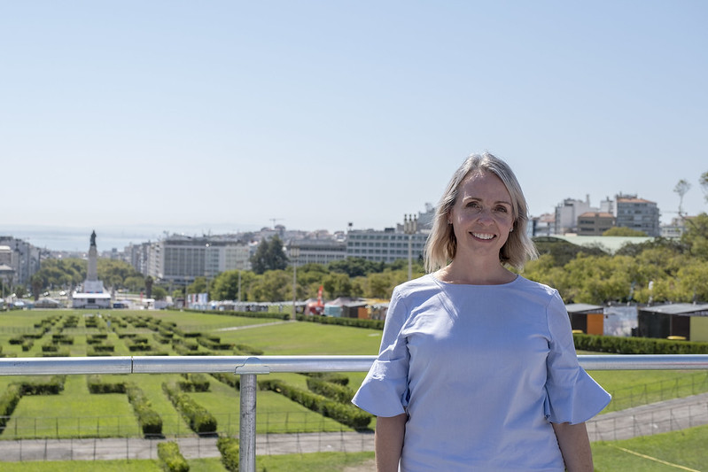
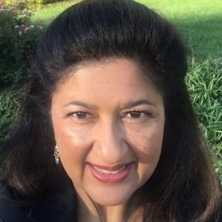
Penny Rechkemmer, the new Public Affairs Officer at the U.S. Embassy in Portugal, began her career at the State Department through an American Association for the Advancement of Science (AAAS) Diplomacy Fellowship. Her experiences in the Office of International Women’s Issues, and Bureau of International Organizations led her to join the Foreign Service where she’s served in Mumbai, Lima, and Nassau. Before coming to the State Department, she worked as a research fellow at Johns Hopkins University with at risk youth in one of Baltimore’s most socio-economically disadvantaged neighborhoods. She also worked for the California State Health Department where she focused on environmental health issues in immigrant and native populations.
(https://pt.usembassy.gov/pt/meet-our-new-public-affairs-officer-pt/)
Sujoya Roy, Deputy Public Affairs Officer at the U.S. Embassy in Lisbon, has been a member of the U.S. diplomatic corps since 2012. She has served in in Guadalajara, Mexico; Naples, Italy; Washington, DC; and, Monrovia, Liberia. Prior to joining the U.S. Foreign Service Sujoya worked for several years in the financial services sector (reinsurance and private equity) in New York City. Her Master’s degree in International Business is from Columbia University in New York.

Slide 3
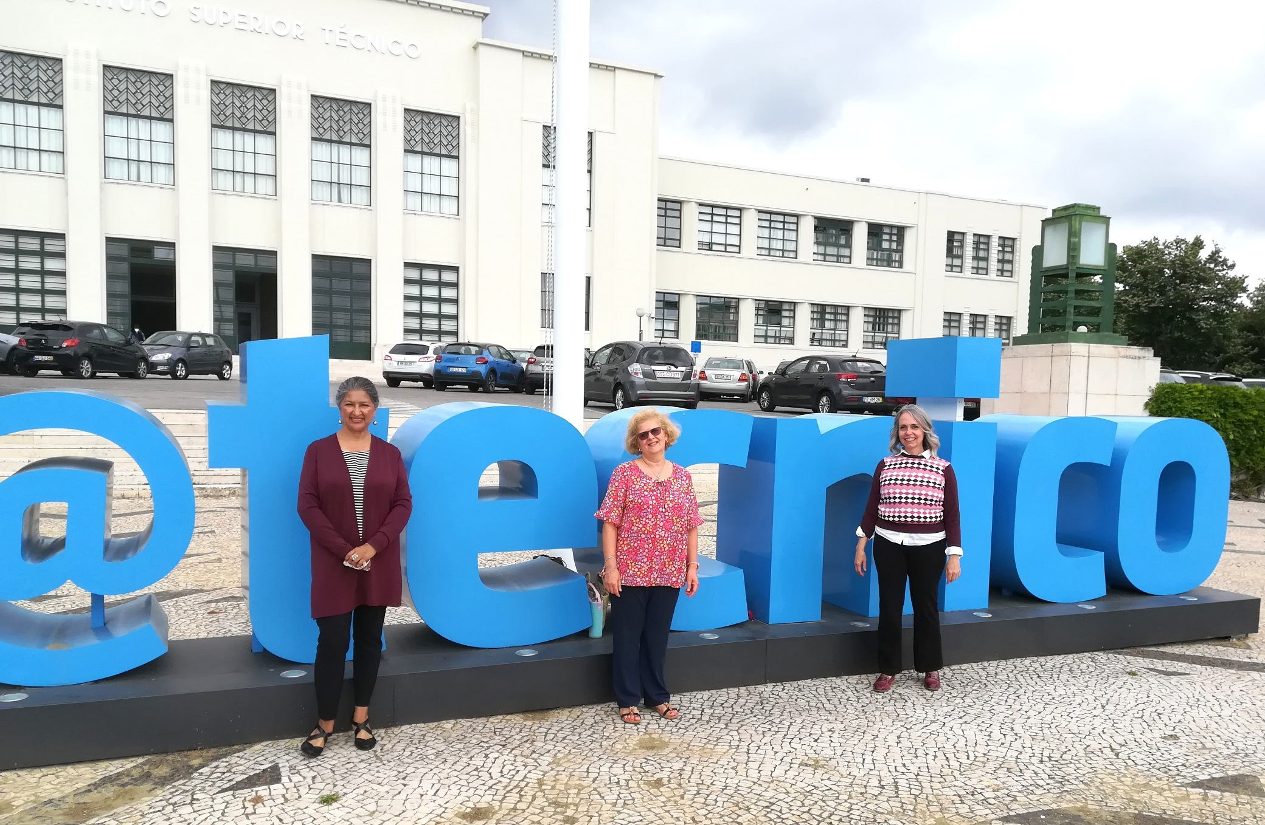
16-06-2021

